Slide 1
Introduction to Java
Università di Modena e Reggio Emilia
Prof. Nicola Bicocchi (nicola.bicocchi@unimore.it)

Slide 2
Java Timeline
1991: SUN develops a programming language for cable TV set-top boxes
1996: Java 1
1996: Netscape supports Java. Popularity grows
1998: Java 2 (libraries)
2005: Java 5 (major enhancements)
2014: Java 8
https://en.wikipedia.org/wiki/Java_version_history

Slide 3
Java Features
Platform independence (portability)
Write once, run everywhere
Translated to intermediate language (bytecode)
Pure OO language
Strong type model and no pointers
Exceptions as a pervasive mechanism
Shares many syntax elements w/ C++ (learning curve less steep)
Automatic garbage collection
Run time loading and linking

Slide 4
Java Programs
Application
It’s a common program, similar to C/C++
Runs through the Java interpreter (Java) of the installed Java Virtual Machine (JVM)
Servlet (Web server)
Java program that extends the capabilities of a Web server
Java counterpart to other dynamic Web content technologies such as PHP and ASP.NET

Slide 5
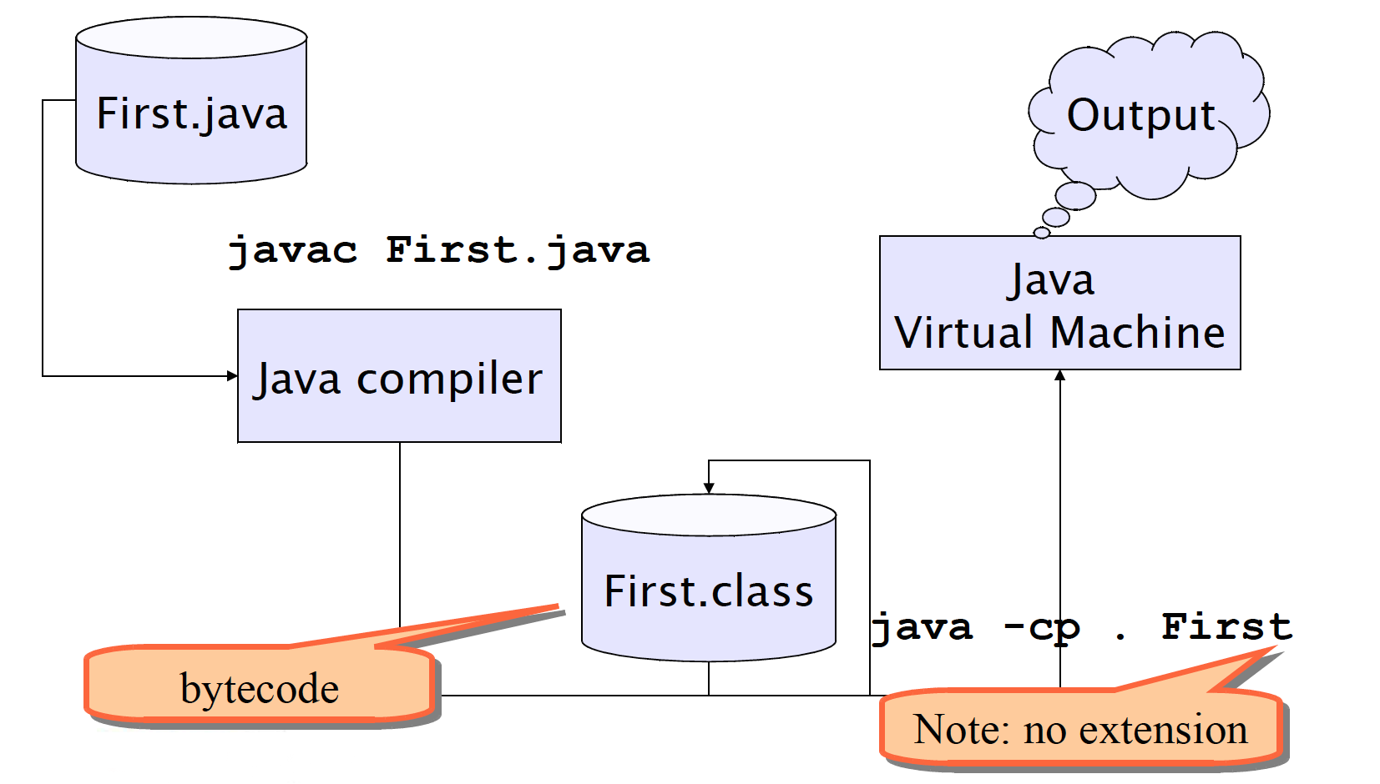
Building and running

Slide 6
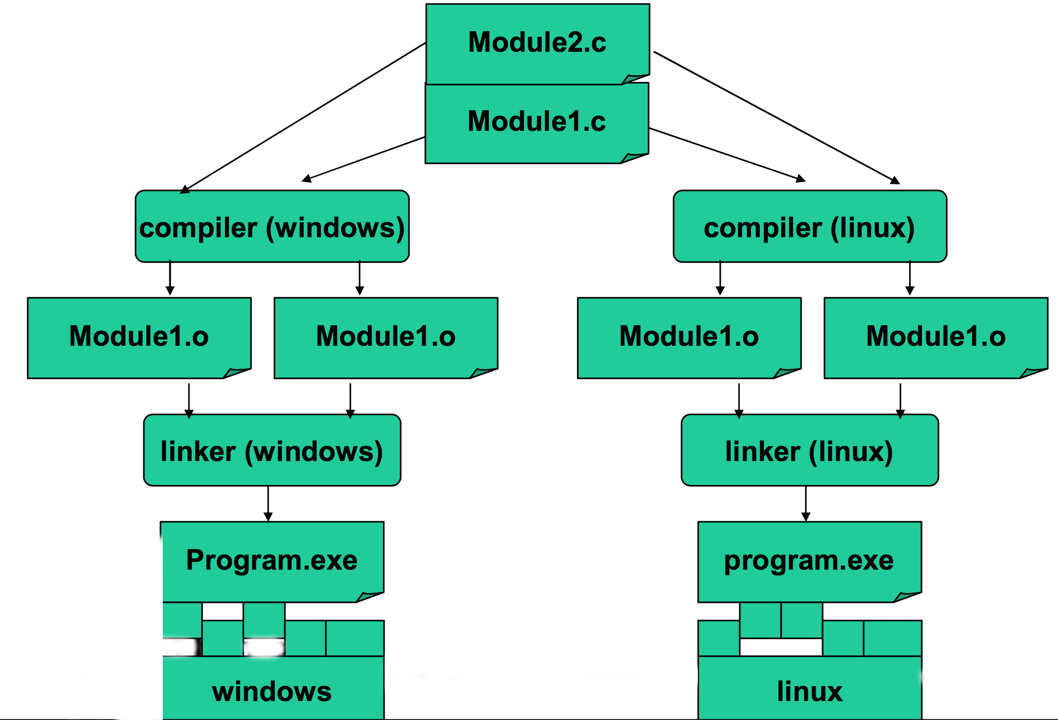
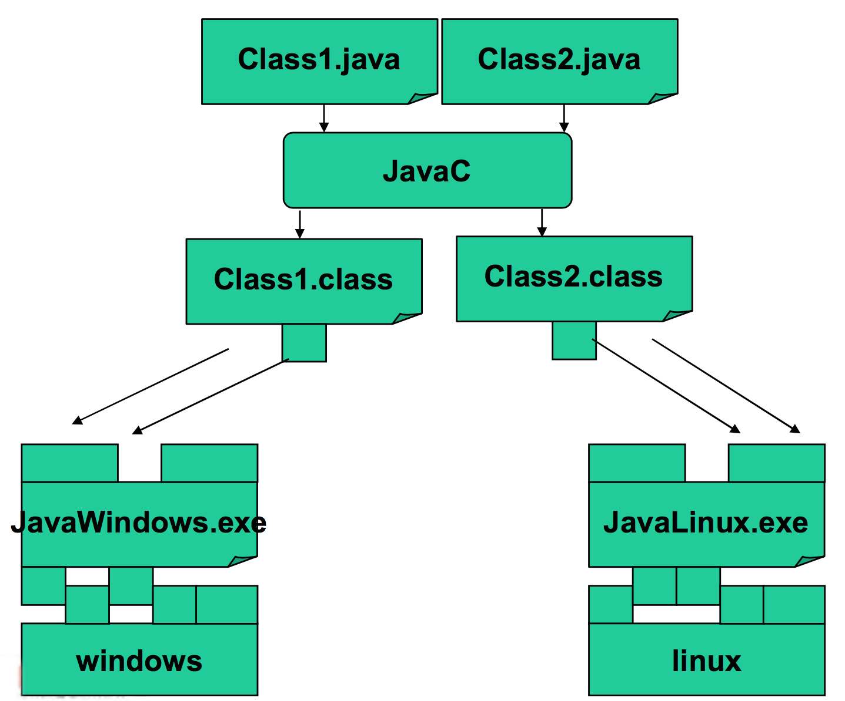
Compiled vs Interpreted

Slide 7
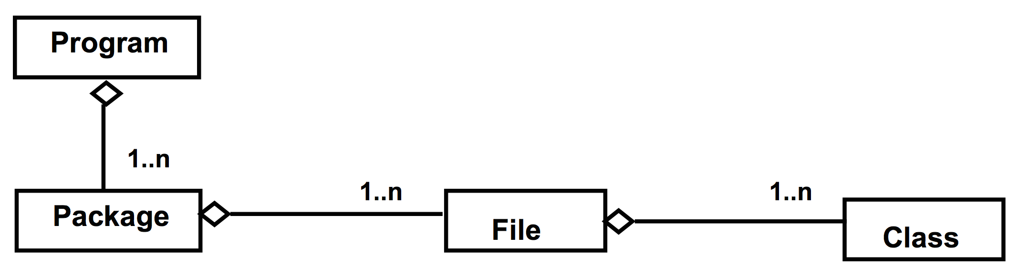
Program, files and classes
A program is made of one or more packages, containing one or more files
A file contains one public class and, optionally, multiple private classes. The file name must be equal to the public class name.

Slide 8
public static void main(String[] args)
In Java there are no functions, but only methods within classes
The execution of a Java program starts from a special method:
public static void main(String[] args) {
…
}

Slide 9
Basic concepts

Slide 10
Comments
C-style comments (multi-lines)
/*
* this comment is so long
* that it needs two lines
*/
Comments on a single line
// comment on one line

Slide 11
Code blocks and Scope
Java code blocks are the same as in C language
Each block is enclosed by braces { } and starts a new scope for the variables
Variables can be declared both at the beginning and in the middle of block code
for (int i=0; i<10; i++){
int x = 12; ... int y;
...
}

Slide 12
Control statements
Same as C
if-else
switch-case
while
do-while
for
break
continue

Slide 13
Passing Parameters
Parameters are always passed by value
...they can be primitive types or object references
Note well: only the object reference is copied not the value of the object

Slide 14
Passing Parameters
public class Parameters {
public static void main(String[] args) {
Point p1 = new Point(0, 0);
Point p2 = new Point(10, 10);
System.out.println(p1);
System.out.println(p2);
swap(p1, p2);
System.out.println(p1); // 0, 0
System.out.println(p2); // 10, 10
}
public static void swap(Point p1, Point p2) {
Point tmp = p1;
p1 = p2;
p2 = tmp;
}
}
main()
heap
swap()
p1
(0, 0)
p1
p2
(10, 10)
p2

Slide 15
Passing Parameters
public class Parameters {
public static void main(String[] args) {
Point p1 = new Point(0, 0);
Point p2 = new Point(10, 10);
System.out.println(p1);
System.out.println(p2);
move(p1, p2);
System.out.println(p1); // 10, 10
System.out.println(p2); // 0, 0
}
public static void move(Point p1, Point p2) {
p1.move(10, 10);
p2.move(0, 0);
}
}
main()
move()
p1
(0, 0)
p1
p2
(10, 10)
p2

Slide 16
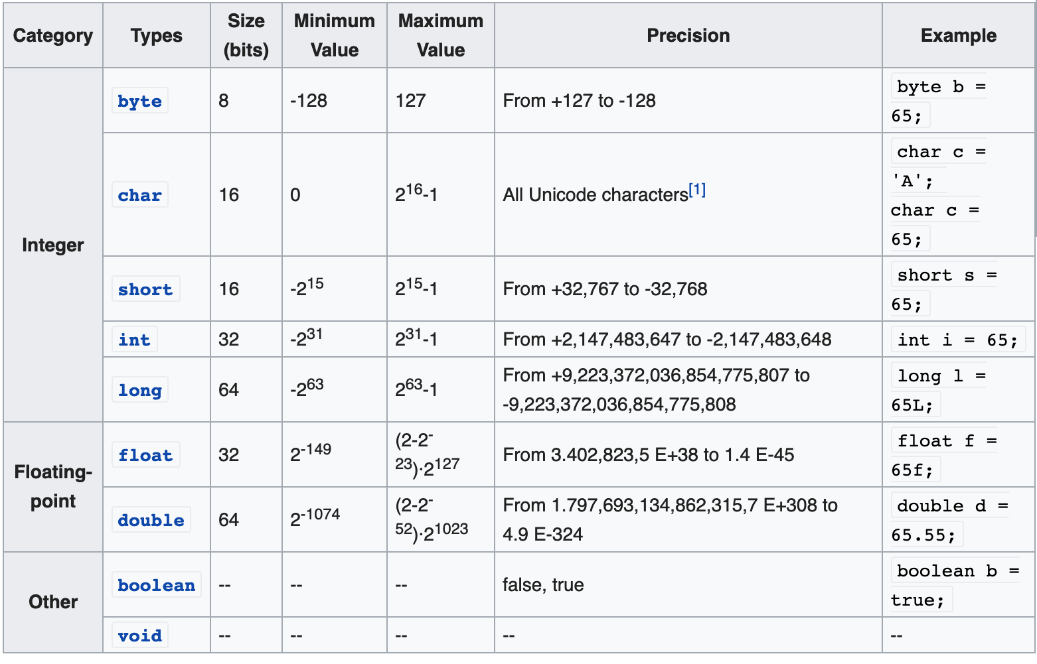
Primitive types

Slide 17
Constants
The final modifier
final float PI = 3.1415;
PI = 16.0; // ERROR, no changes allowed
Use uppercases (coding conventions)

Slide 18
Operators (integer and floating-point)
Operators follow C syntax:
arithmetical + - * / %
Relational == != > < >= <=
bitwise & | ^ ! >> <<
Logical && || ! ^
Assignment = += -= *= /= %= &= |= ^=
Increment ++ --
Chars can be treated as integers (e.g. switch)
Logical operators work ONLY on booleans. int is NOT considered a boolean value like in C

Slide 19
Switch with chars
public class Test {
public static void main(String args[]) {
char grade = ‘A';
switch(grade) {
case 'A' :
System.out.println("Excellent!");
break;
case 'B' :
case 'C' :
System.out.println("Well done");
break;
case 'D' :
System.out.println("You passed");
case 'F' :
System.out.println("Better try again");
break;
default :
System.out.println("Invalid grade");
}
System.out.println("Your grade is " + grade);
}
}

Slide 20
Coding Conventions
class ClassName {
final double PI = 3.14;
private int attributeName;
public void methodName {
int var;
if (var == 0) {
/* this is a comment*/
}
}
}
In Eclipse: CTRL+A, CTRL-I (Auto Indent)

Slide 21
Strings

Slide 22
String
No primitive type to represent string
C
char s[] = “literal”
Equivalence between string and char arrays
Java
char[] != String
java.lang.String (see Java API)

Slide 23
String
Strings are immutable. the JVM can optimize the amount of memory allocated for them by storing only one copy of each literal String in the pool. This process is called interning.
When we create a String variable and assign a value to it, the JVM searches the pool for a String of equal value. If found, the Java compiler will simply return a reference to its memory address, without allocating additional memory.
If not found, it’ll be added to the pool (interned) and its reference will be returned.
String first = "Baeldung";
String second = "Baeldung";
System.out.println(first == second); // True

Slide 24
String
Let’s create two different objects using new and check that they have different references:
String first = new String("Baeldung");
String second = new String("Baeldung");
String third = "Baeldung";
System.out.println(first == second); // False
System.out.println(first == third); // False

Slide 25
String
String: an object storing a sequence of text characters.
Creating a string:
String name = "text";
String name = expression;
Examples:
String name = "Marty Stepp";
int x = 3;
int y = 5;
String point = "(" + x + ", " + y + ")";

Slide 26
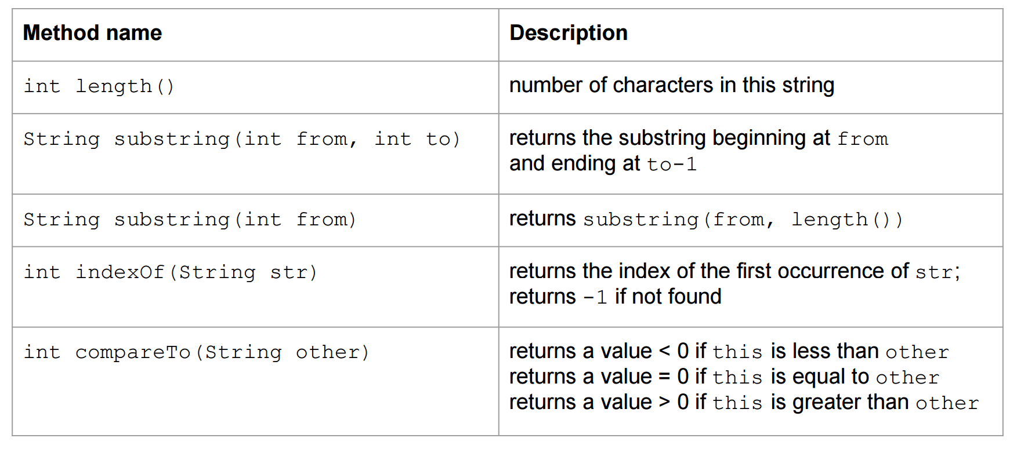
String

Slide 27
The equals method
Objects (not only Strings) are compared using a method named equals.
String s1, s2;
if (s1 == s2) {
System.out.println("s1 and s2 refer to the same object");
}
if (s1.equals(s2)) {
System.out.println(”s1 and s2 refer to objects having the same content!");
}

Slide 28
Operator +
It is used to concatenate 2 strings
String s = “This string” + “is made by two strings”
Works also with other types (automatically converted to string)
System.out.println(“pi = ” + 3.14);
System.out.println(“x = ” + x);

Slide 29
StringBuilder
Java Strings are immutable. They are never actually modified. When two Strings are concatenated, the two Strings are actually discarded and a new one - containing their concatenation - is instantiated.
This process is slow!
Use StringBuilder, istead!
public static void main(String[] args) {
// slow version
String s = "";
for (int i = 0; i < 100; i++) {
s += 'a';
}
System.out.println(s);
// fast version using StringBuilder
StringBuilder sb = new StringBuilder();
for (int i = 0; i < 100; i++) {
sb.append('a');
}
System.out.println(sb.toString());
}

Slide 30
Array

Slide 31
Array
An array is an ordered sequence of variables of the same type which are accessed through an index
Can contain both primitive types or object references (no actual objects!)
Array size must be defined at creation time (cannot change afterwards)

Slide 32
Array declaration
An array reference can be declared with one of these equivalent syntaxes
int[] v, int v[]
Point[] v, Point v[]
An array is an Object, must be created using new, and it is stored in the heap (as all objects)
Array declaration (e.g., int[] v) allocates memory space for the reference only, which has default value = null

Slide 33
Array creation
Using the new operator
int[] v = new int[256];
Using static initialization, filling the array with values
int[] v = {2,3,5,7,11,13};

Slide 34
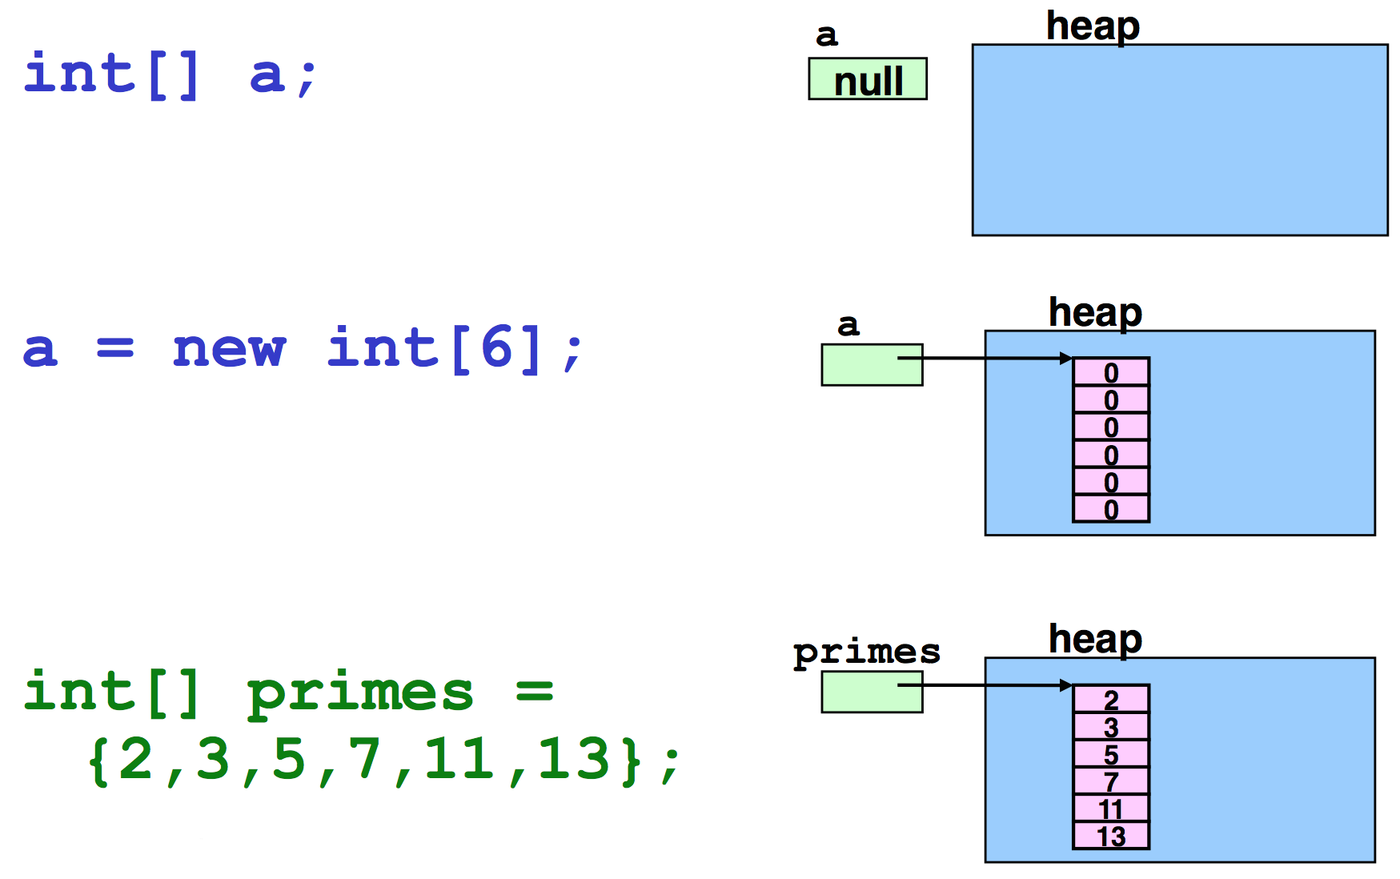
Example – Primitive types

Slide 35
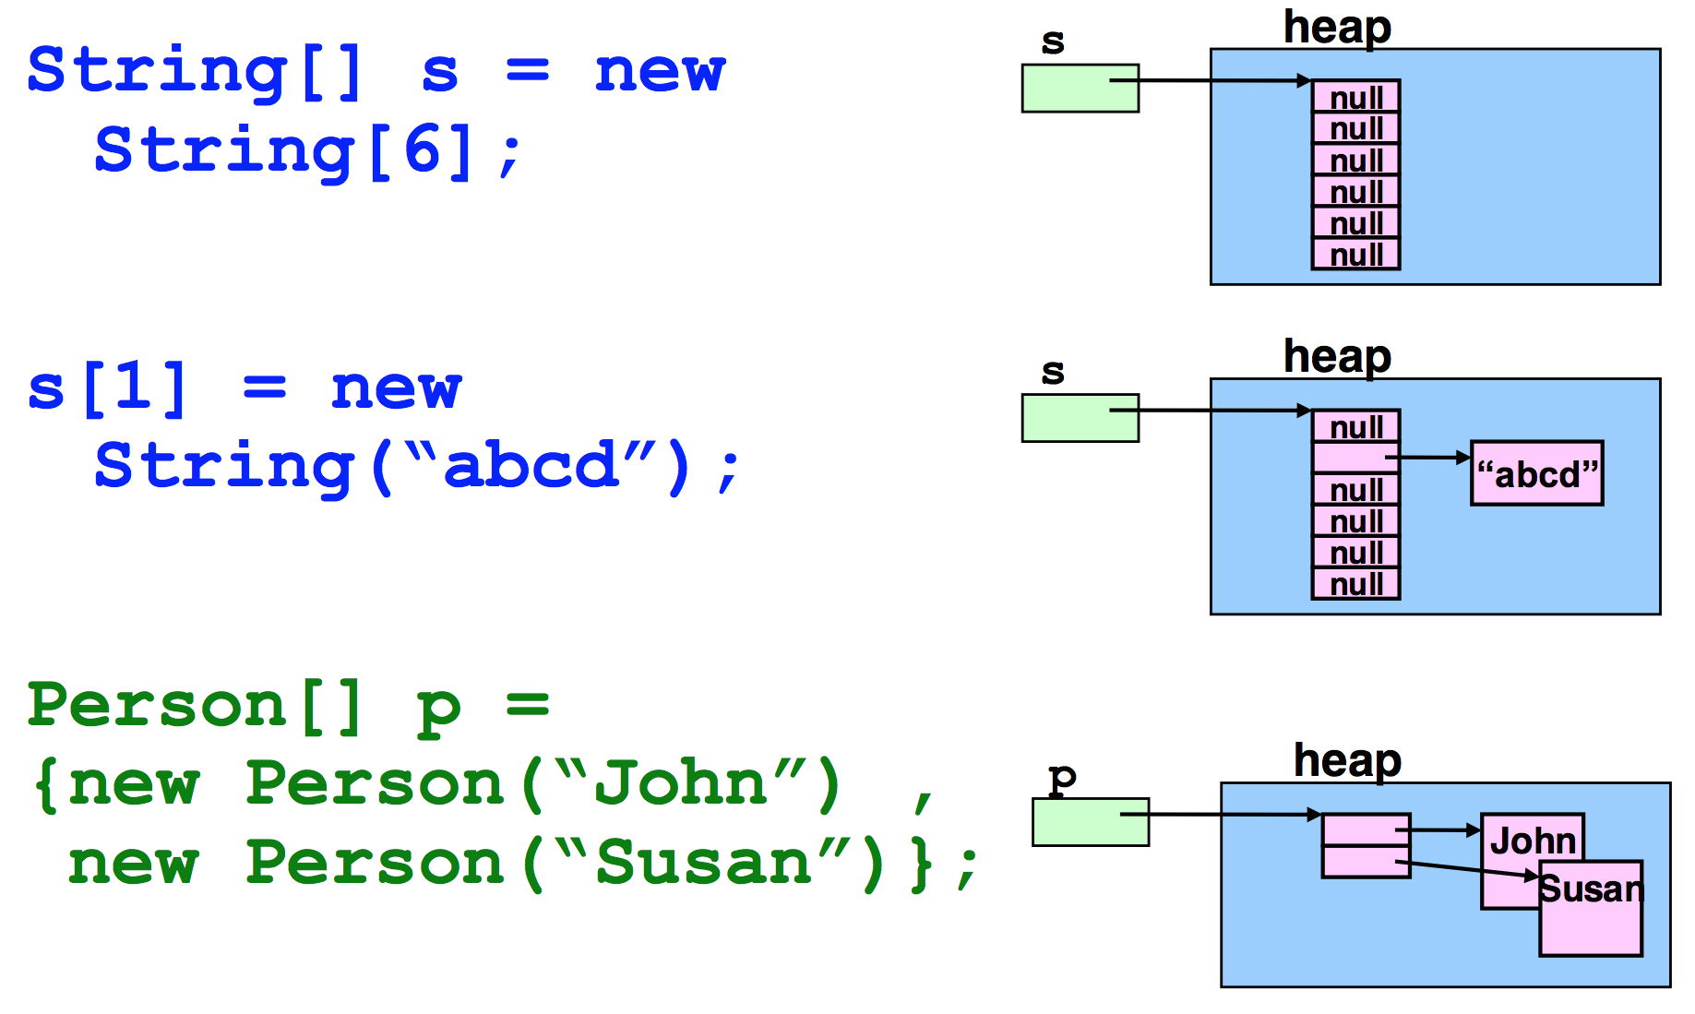
Example – Object reference

Slide 36
Operations on arrays
Java checks array bounds at runtime
int[] v = new int[16]
System.out.println(v[20])
ArrayIndexOutOfBoundsException
The length of an array (the maximum capacity of the array) is provided by the attribute length. Not to be confused with the size() method provided by the Collection interface!
for (int i=0; i < v.length; i++) {
v[i] = i;
}

Slide 37
Operations on arrays
An array reference is not a pointer to the first element of the array
It is a reference to the array object
Arithmetic on pointers does not exist in Java
// error!
int[] v1 = new int[16]; int[] v2 = v1 + 2;

Slide 38
Operations on arrays
New loop construct: for( Type var : set_expression )
set_expression can be either
an array
a class implementing Iterable (see Java Collection Framework)
The compiler can automatically loop with correct indexes
less error prone

Slide 39
For each
String[] args;
/* implicit index (also called for-each syntax) */
for(String arg: args){
System.out.println(arg);
//...
}
/* explicit index */
for(int i = 0; i < args.length; i++){
System.out.println(args[i]); //...
}

Slide 40
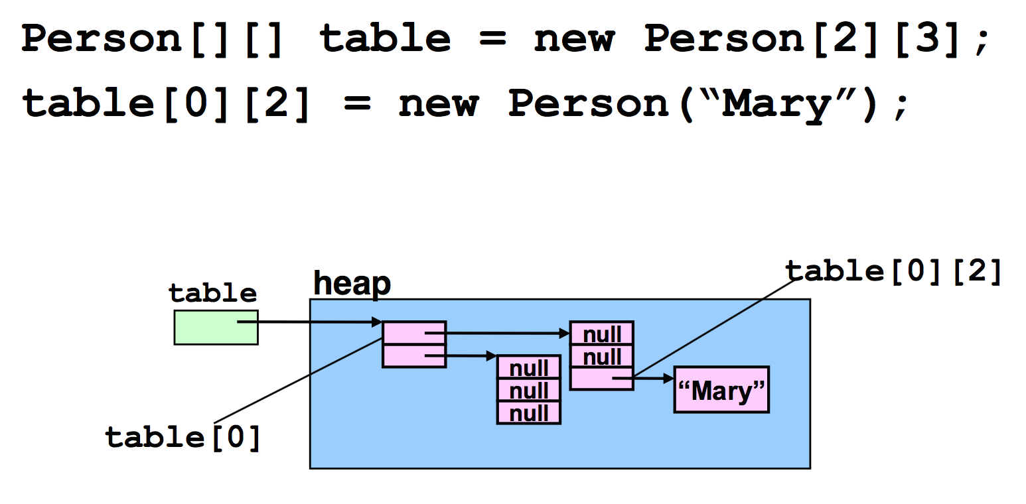
Multidimensional array
Implemented as array of arrays

Slide 41
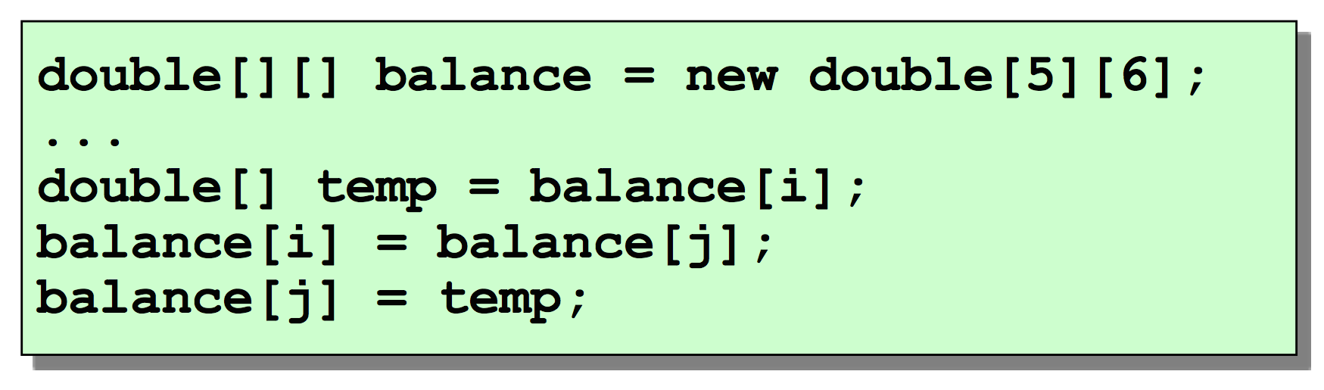
Rows and columns
As rows are not stored in adjacent positions in memory they can be easily exchanged

Slide 42
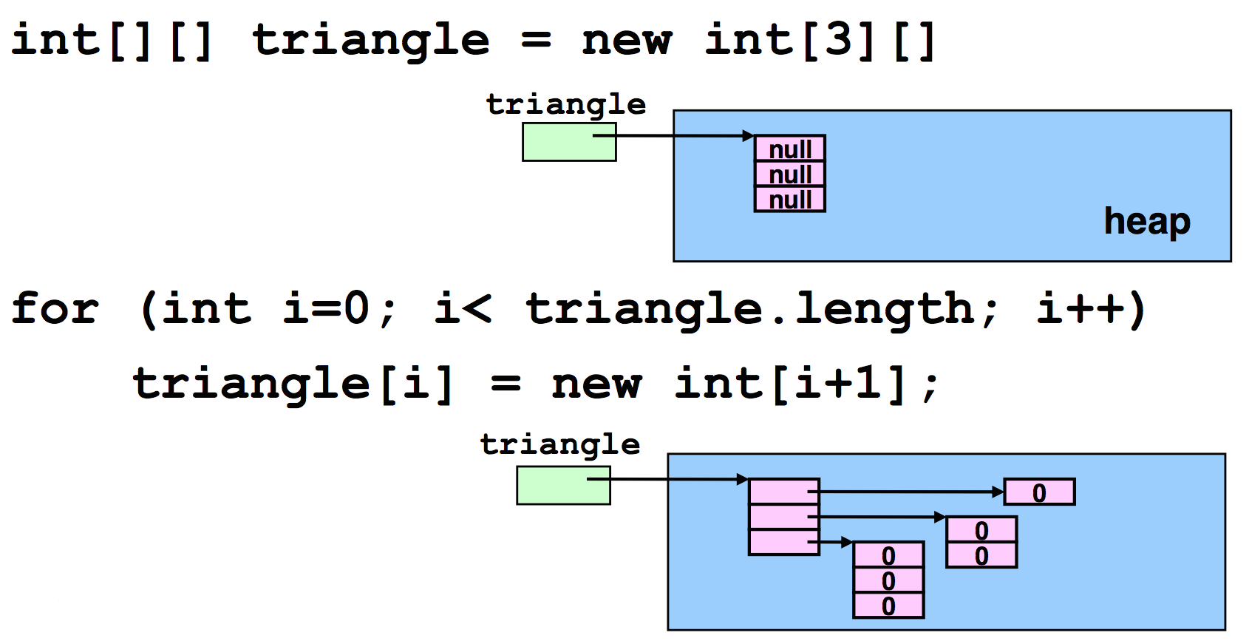
Rows with different length
A matrix (bi-dimensional array) is indeed an array of arrays

Slide 43
java.util.Arrays
Alter-ego of java.util.Collections
This class contains various methods for manipulating arrays such as sorting, searching, filling, printing or being viewed as Lists
binarySearch()
sort()
fill()
toString()
asList()

Slide 44
System.arraycopy()
System.arraycopy() copies an array from the specified source array, beginning at the specified position, to the specified position of the destination array.
A subsequence of array components are copied from the source array referenced by src to the destination array referenced by dest. The number of components copied is equal to the length argument.
public static void arraycopy(Object src, int srcPos, Object dest, int destPos, int length)

Slide 45
Example
public static void main(String[] main) {
Random rnd = new Random();
int[] v1 = new int[10];
int[] v2 = new int[10];
Arrays.fill(v1, 15);
System.out.println("v1 = " + Arrays.toString(v1));
for (int i = 0; i < v1.length; i++) {
v1[i] = rnd.nextInt(100);
}
System.out.println("v1 = " + Arrays.toString(v1));
Arrays.sort(v1);
System.out.println("v1 = " + Arrays.toString(v1));
System.arraycopy(v1, 0, v2, 0, 10);
System.out.println("v2 = " + Arrays.toString(v2));
}
v1 = [15, 15, 15, 15, 15, 15, 15, 15, 15, 15]
v1 = [37, 48, 19, 66, 18, 41, 8, 35, 44, 16]
v1 = [8, 16, 18, 19, 35, 37, 41, 44, 48, 66]
v2 = [8, 16, 18, 19, 35, 37, 41, 44, 48, 66]

